Slide 1
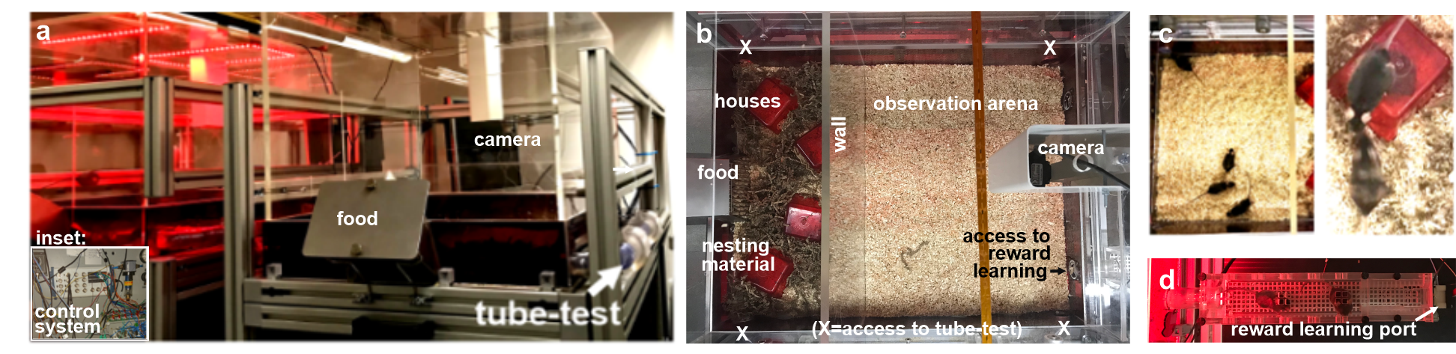
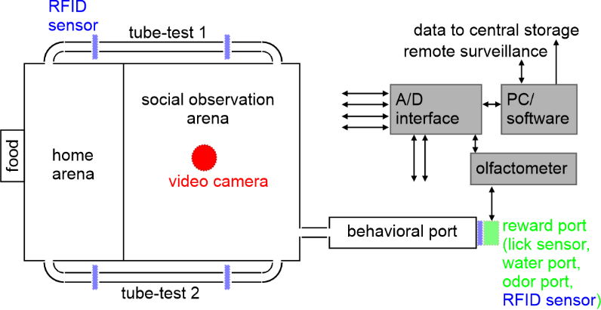
NoSeMaze
- non-invasive sensor-rich maze

Slide 2
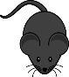
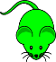



Cohorts
wild-types with
interspersed
OXTR^{ΔAON}
continuous individual tracking
high-dimensional phenotyping
OXTR^{ΔAON} cohort 1
N = 38 C57BL6 >F10
male, 55-94 weeks old
28 controls (OXTRflfl xCre-)
10 OXTR^{ΔAON} (OXTRflfl xCre+)
groups of 10 with 8 controls and 2 OXTR^{ΔAON}
>2 repetitions per mouse
10 rounds in total
OXTR^{ΔAON} cohort 2
N = 41 C57BL6 >F10
male, 16-37 weeks old
25 controls (OXTRflfl xCre-)
16 OXTR^{ΔAON} (OXTRflfl xCre+)
groups of 10 with 7 controls and 3 OXTR^{ΔAON}
>2 repetitions per mouse
8 rounds in total

Slide 3
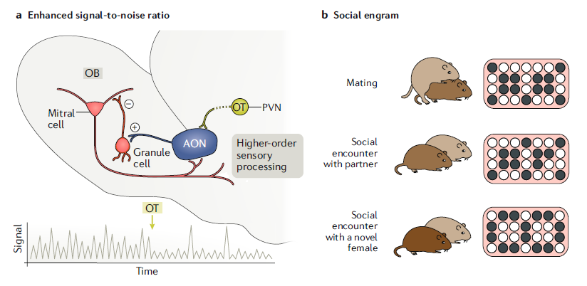
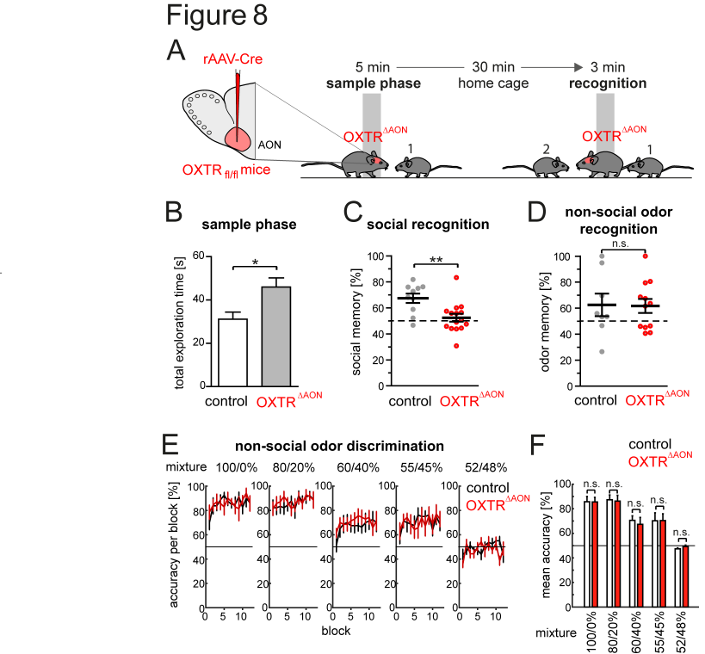
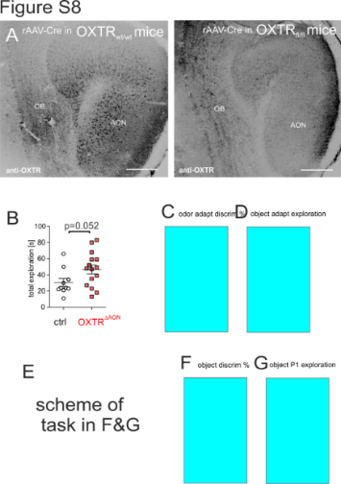
Oxytocin in the AON is required
for social recognition (=lesser approach)
Oxytocin in the AON increases top-down
the signal-to-noise of odor responses
Note:
Mutants do not approach/sample less
summarized in Walum et al., Nature Reviews Neuroscience, 2018
Oettl et al. Neuron, 2016
Notes:
Interestingly more exploration

Slide 4
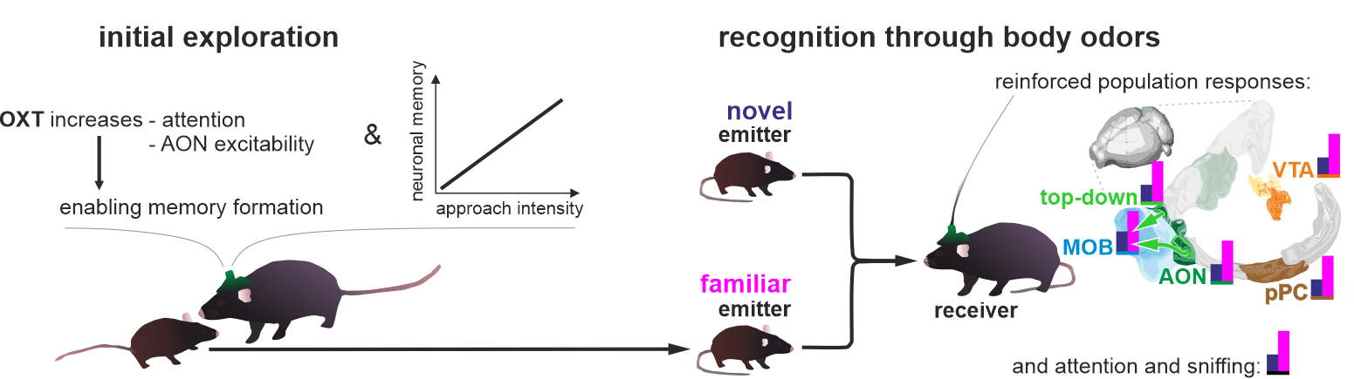
Wolf et al. Nat Comm in press
Oxytocin induces the formation of distinctive cortical representations and cognitions biased toward familiar mice.
Oxytocin modulation in the anterior olfactory cortex
… increases top-down the SNR in olfactory processing
… is required to enable later social recognition (encoding, cognition & behavior)
AON
Retrieved representations of familar animals in primary olfactory cortices
… are reinforced and more distinct from other animals
… with more salience assigned to the familiar

Slide 5
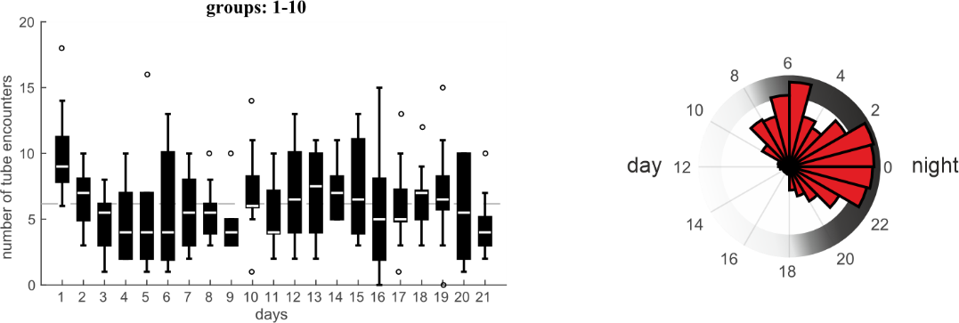
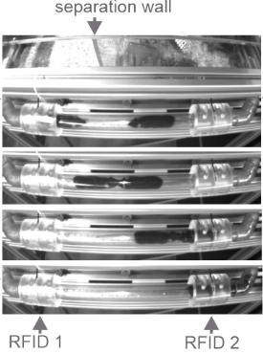
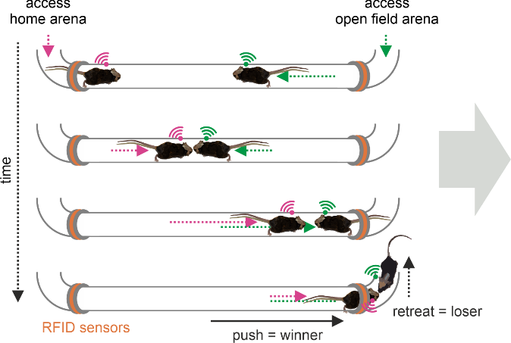
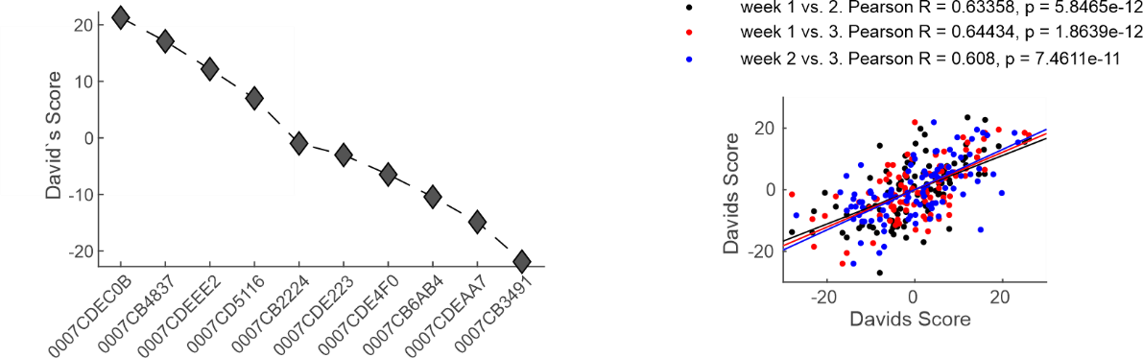
social hierarchy
automated 24/7 tube-test
social hierarchy (David‘s score) is stable over time
social hierarchy is maintained with different conspecifics (shuffling of the groups)

Slide 6
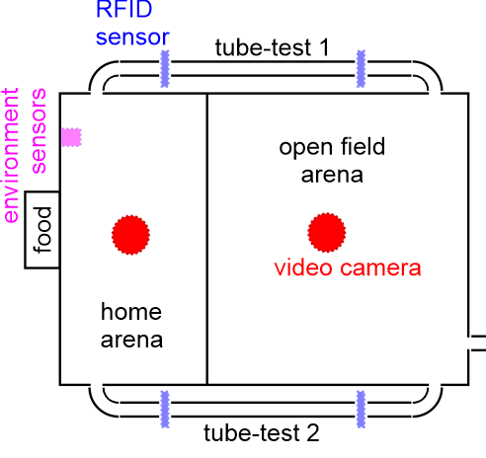
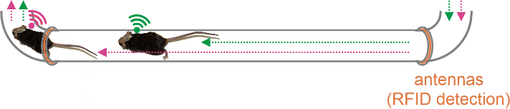
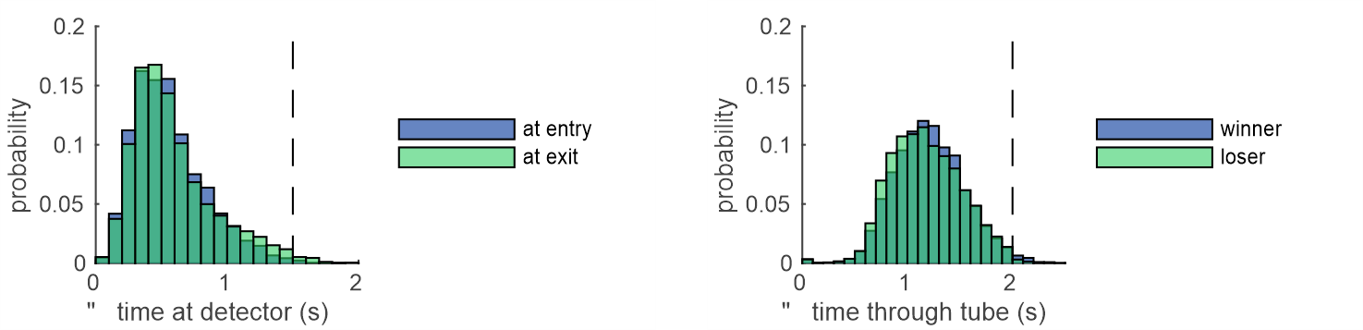
chasing
automated 24/7 chasing assessment
number and fraction of chasings
thresholds
Δ time at detector (1.5s)
time through tube (2s)

Slide 7
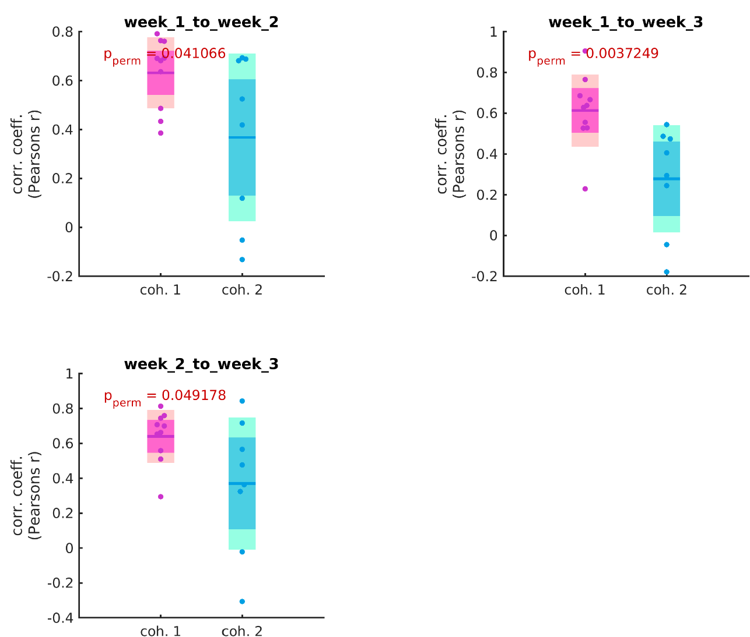
stability of social hierarchy (David‘s score)
higher correlation coefficients of the z-scored DS between different weeks in cohort 1 compared to cohort 2
social hierarchy is more stable in elderly animals

Slide 8
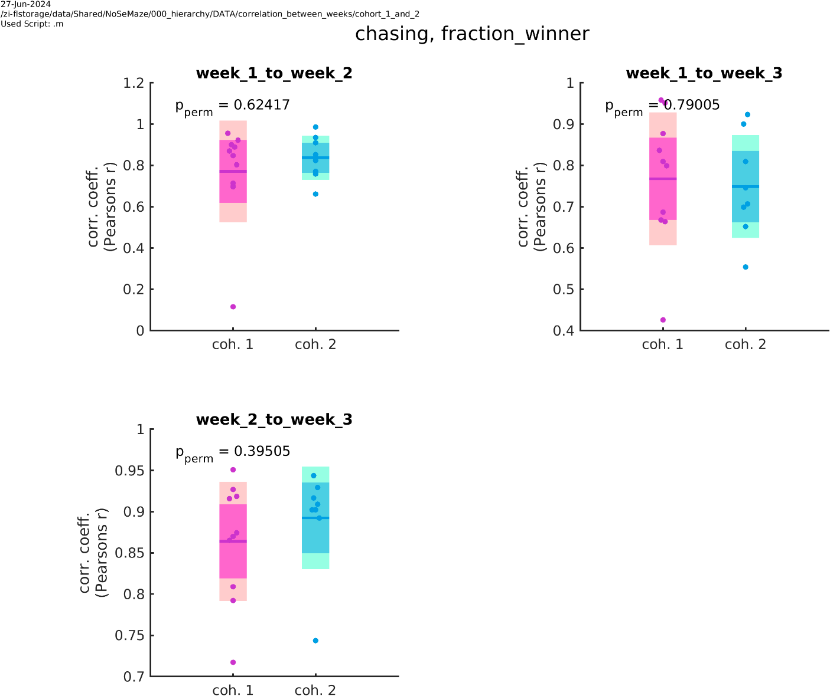
stability of chasing (fraction of wins)
similar stability for chasing (fraction winner)
→ no differences between the two cohorts

Slide 9
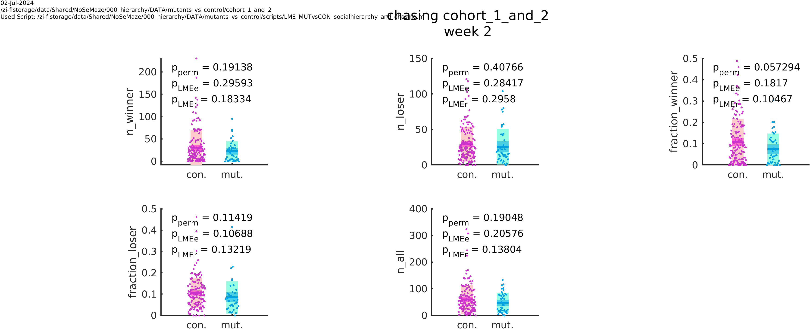
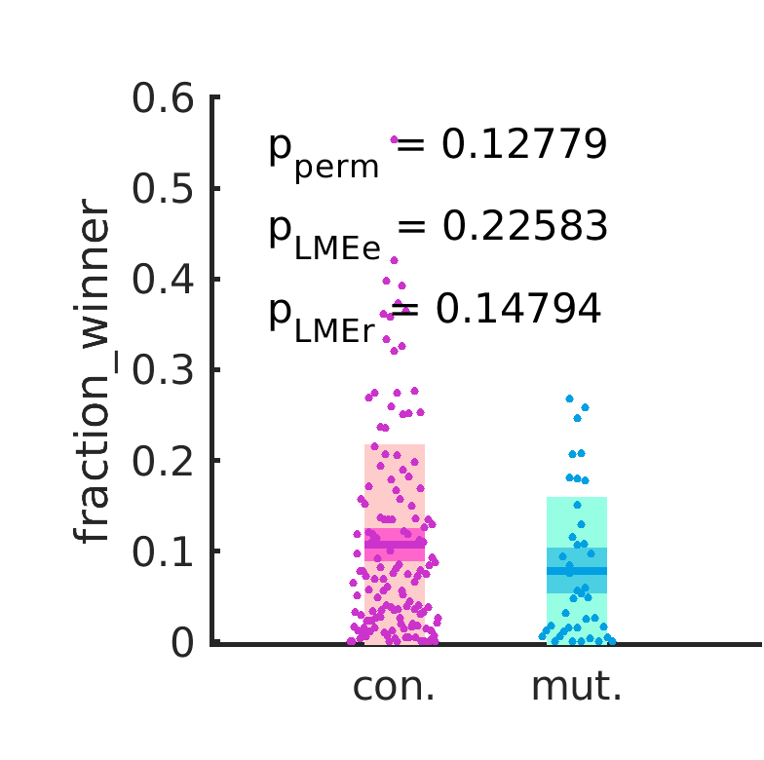
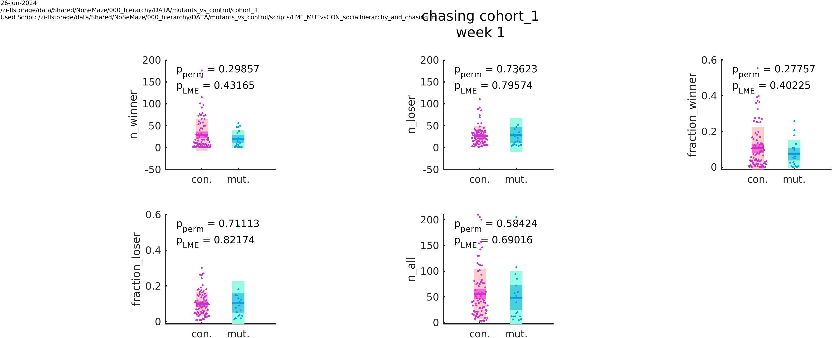
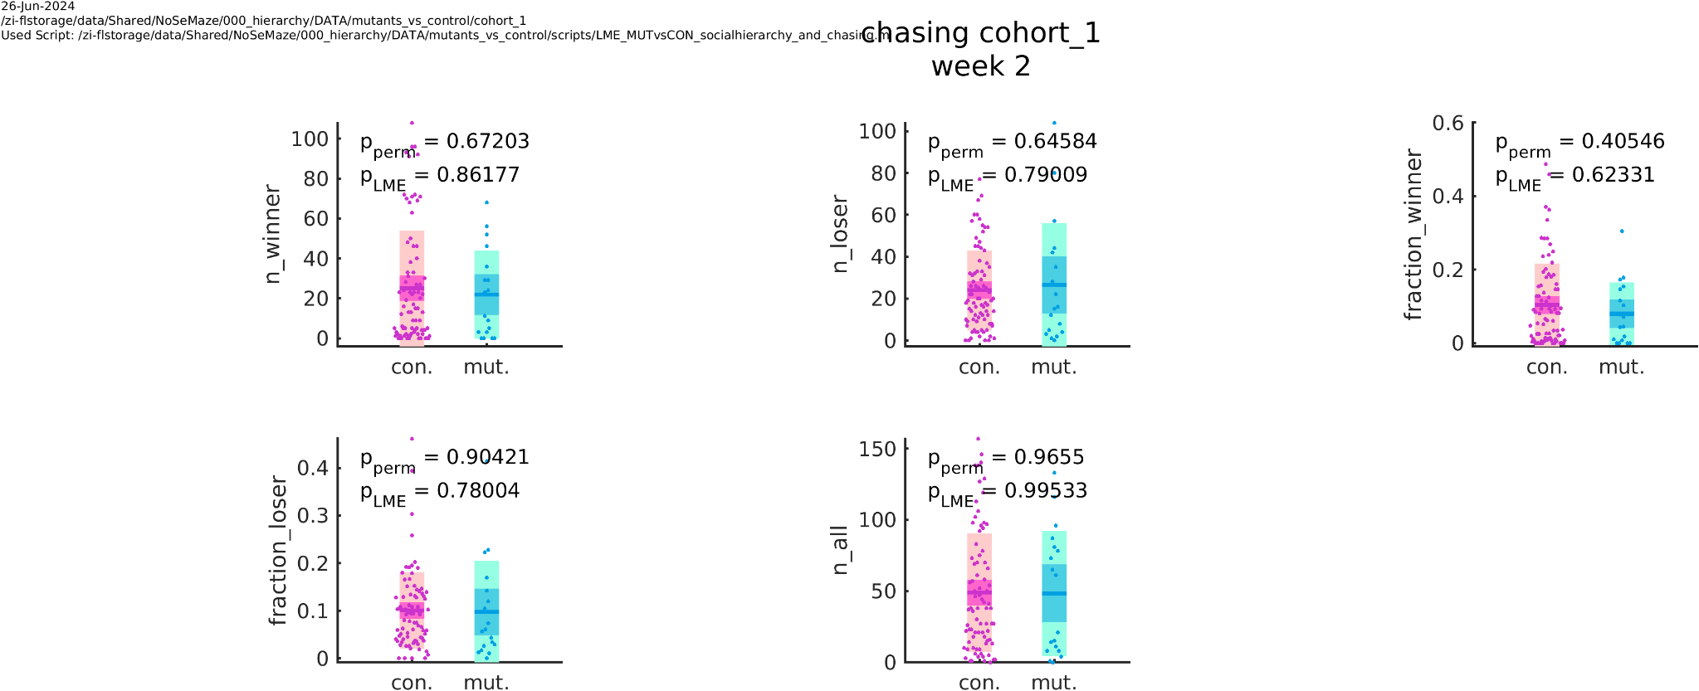
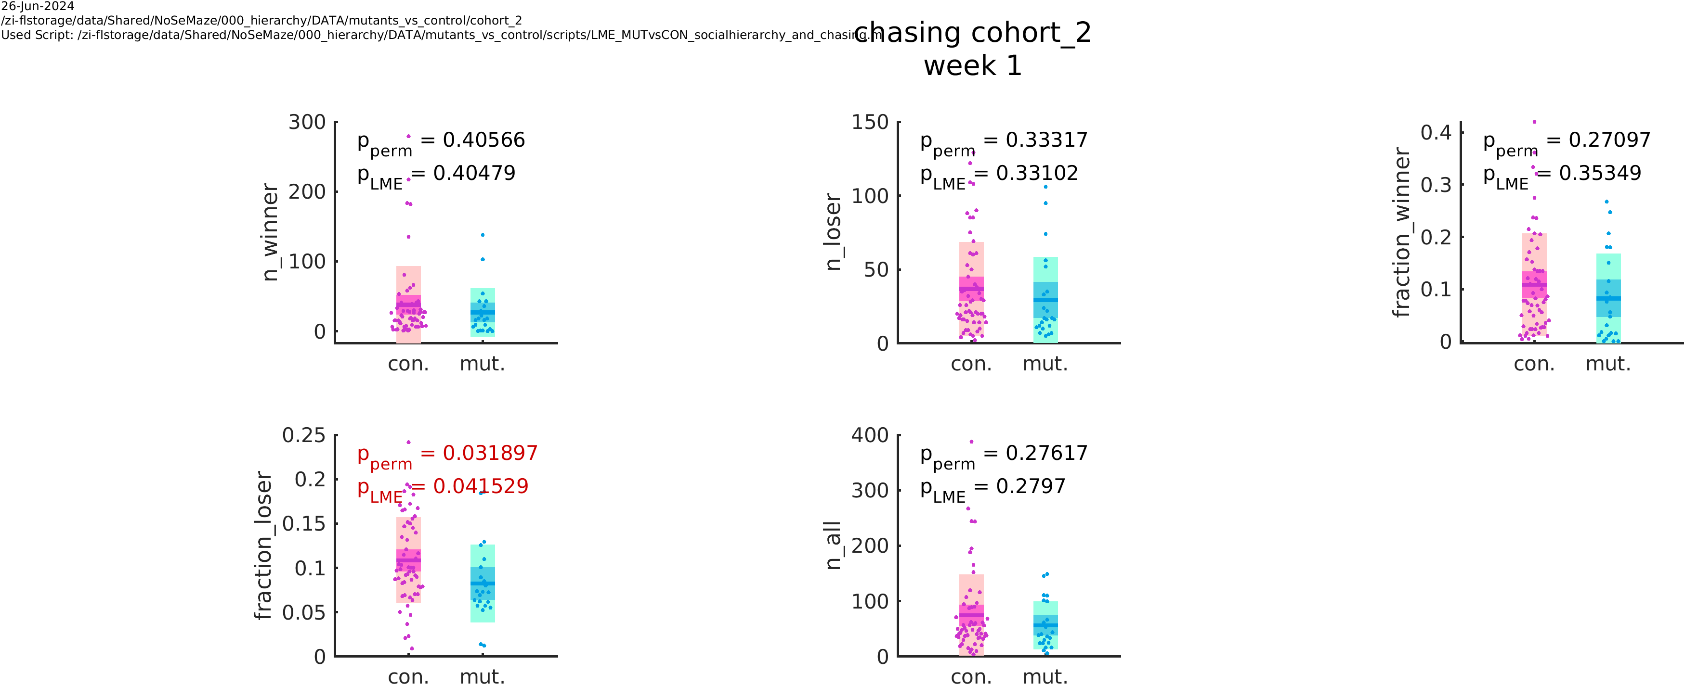
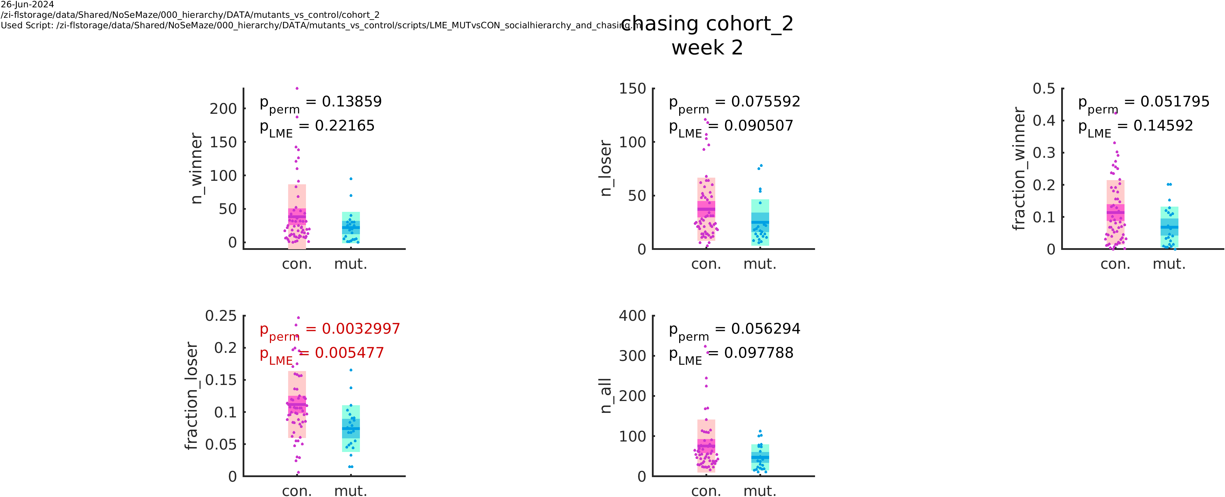
OXTR^{ΔAON} vs controls: chasing
cohort 1 and 2
week 1
week 2
no differences in chasing between mutants and controls (fraction/n)
cohort 1
cohort 2
week 1
week 2
week 1
week 2

Slide 10
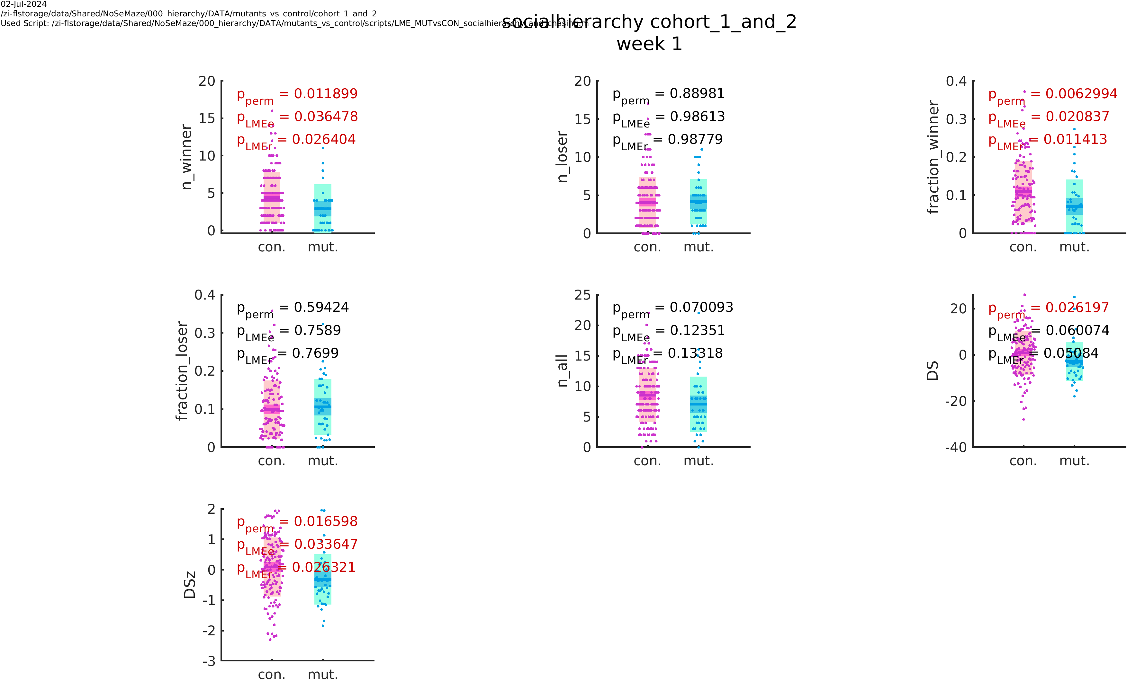
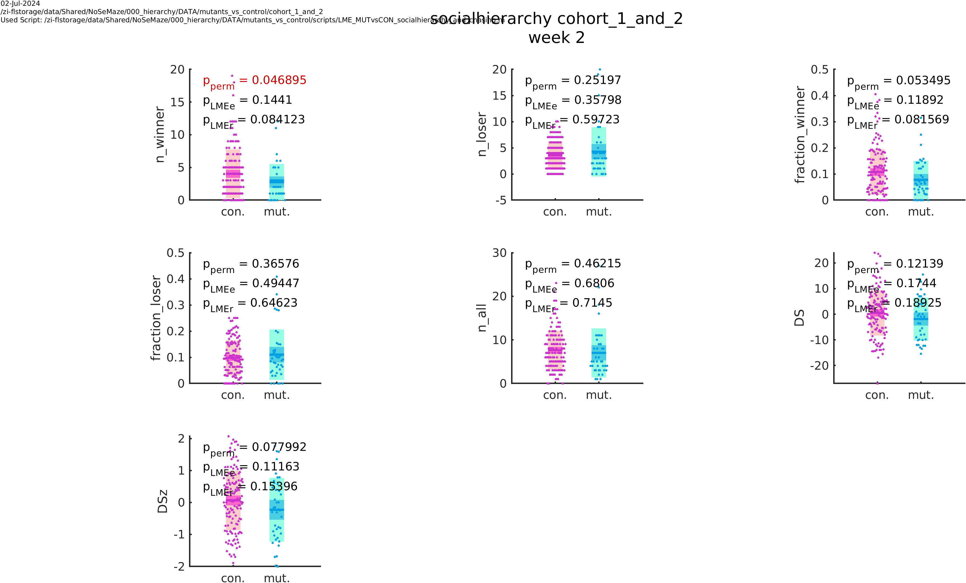
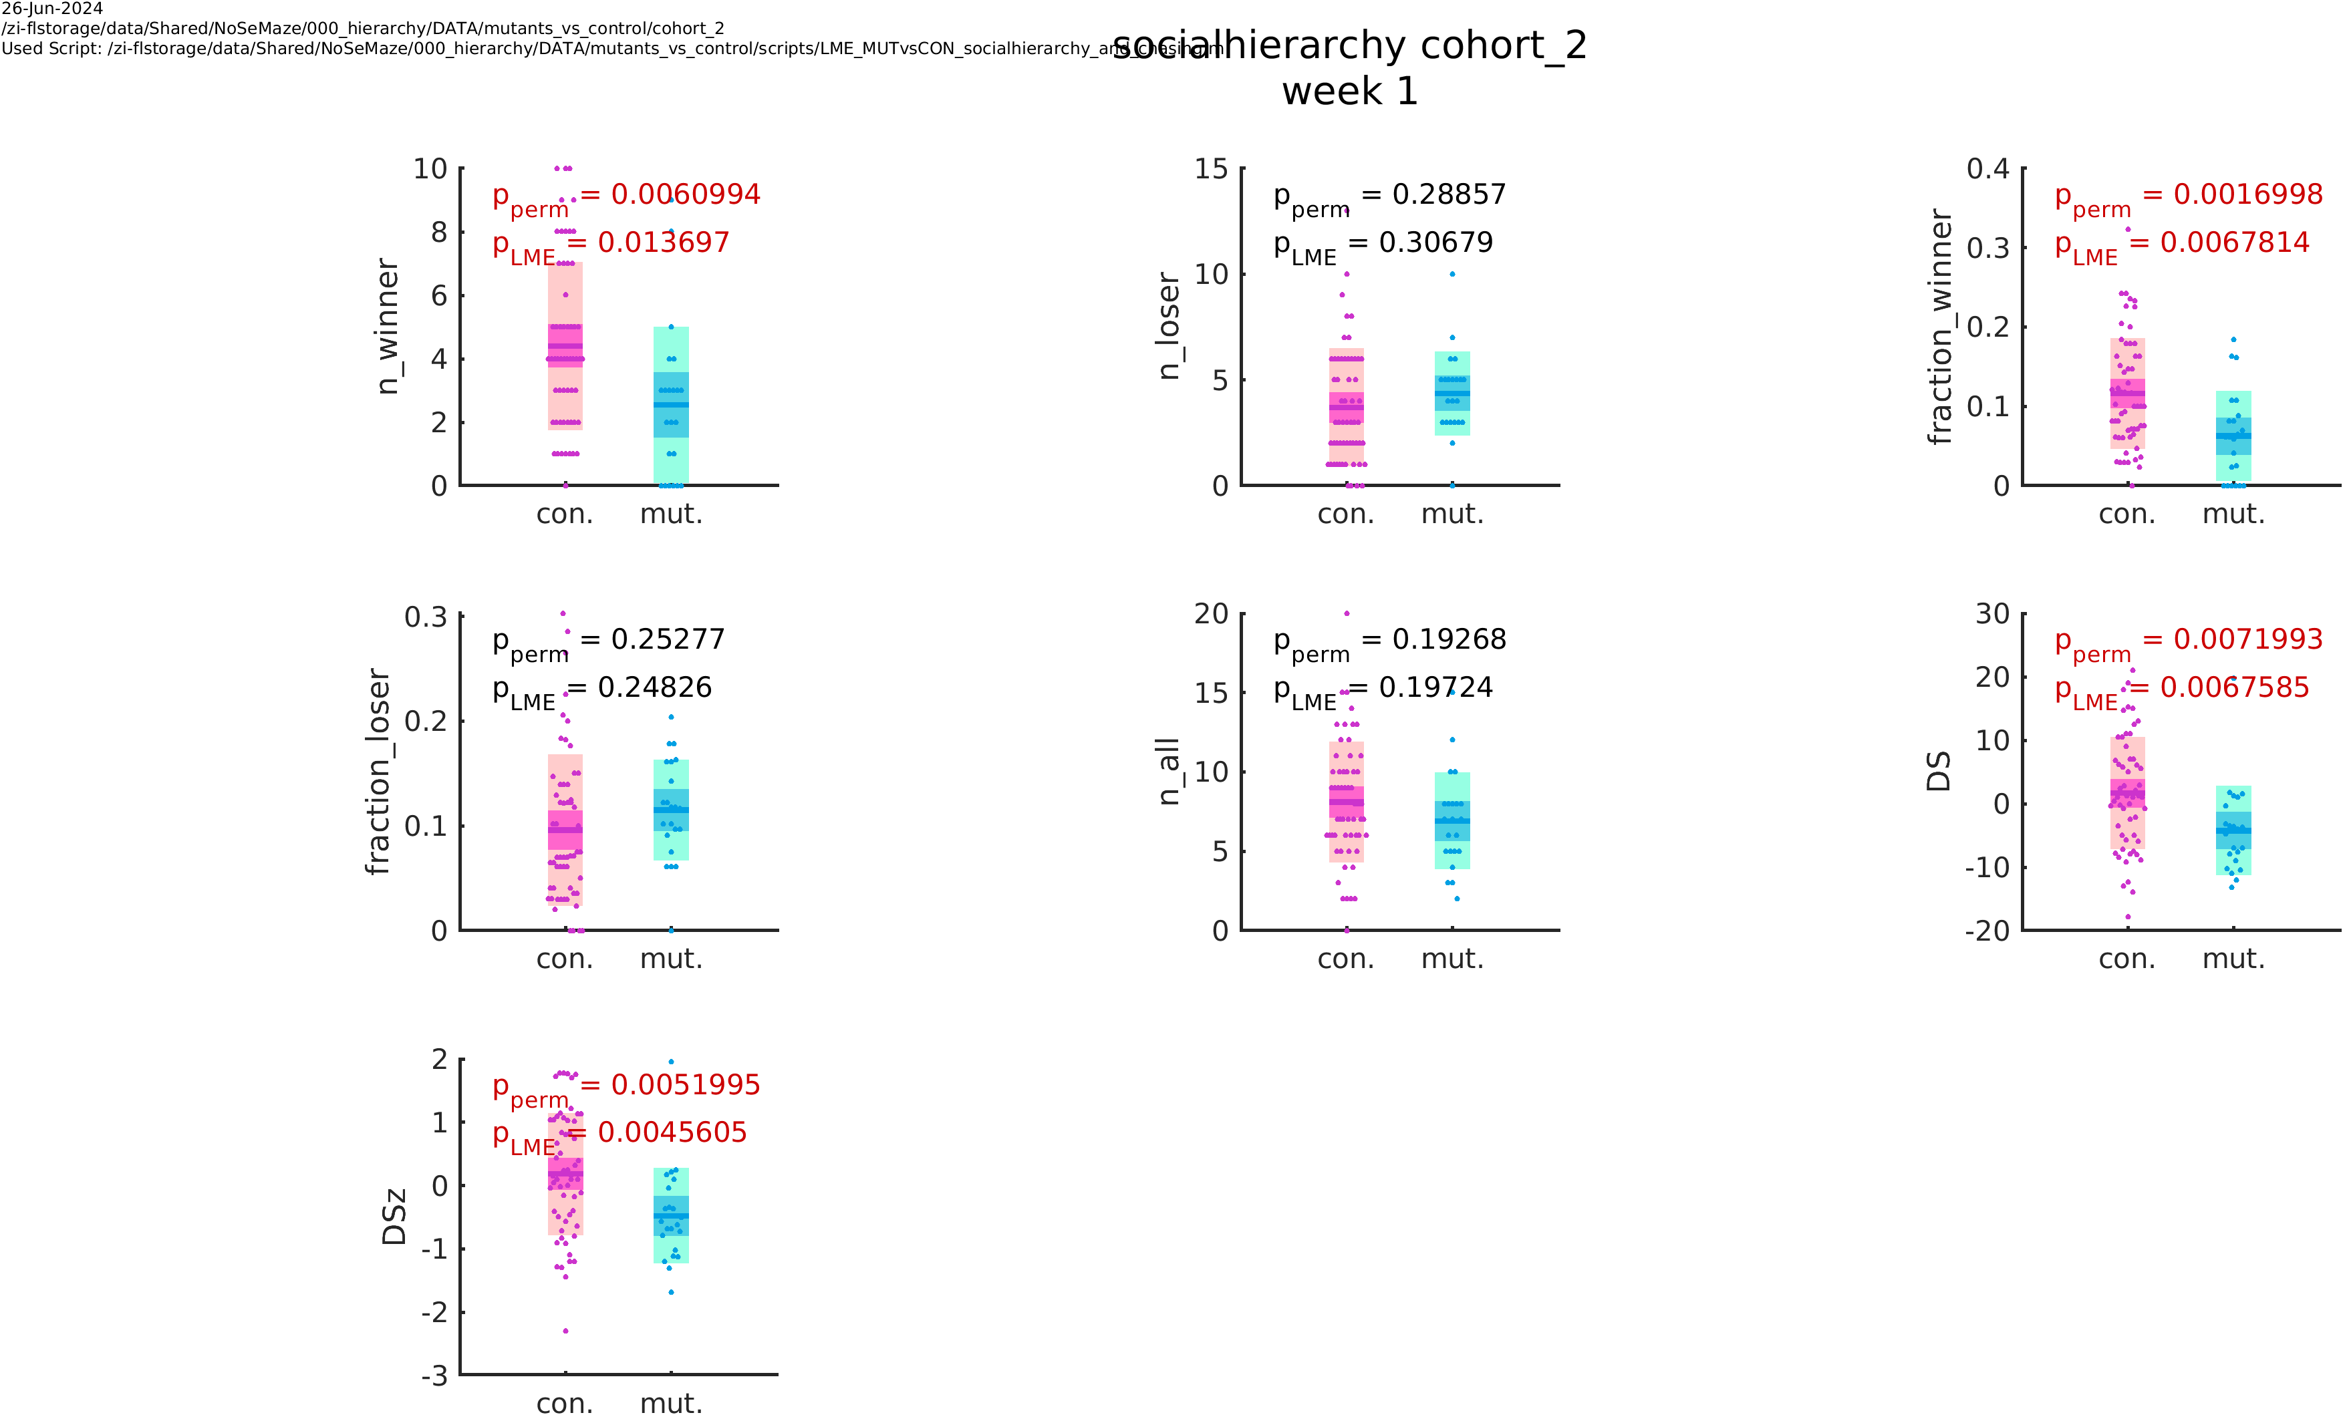
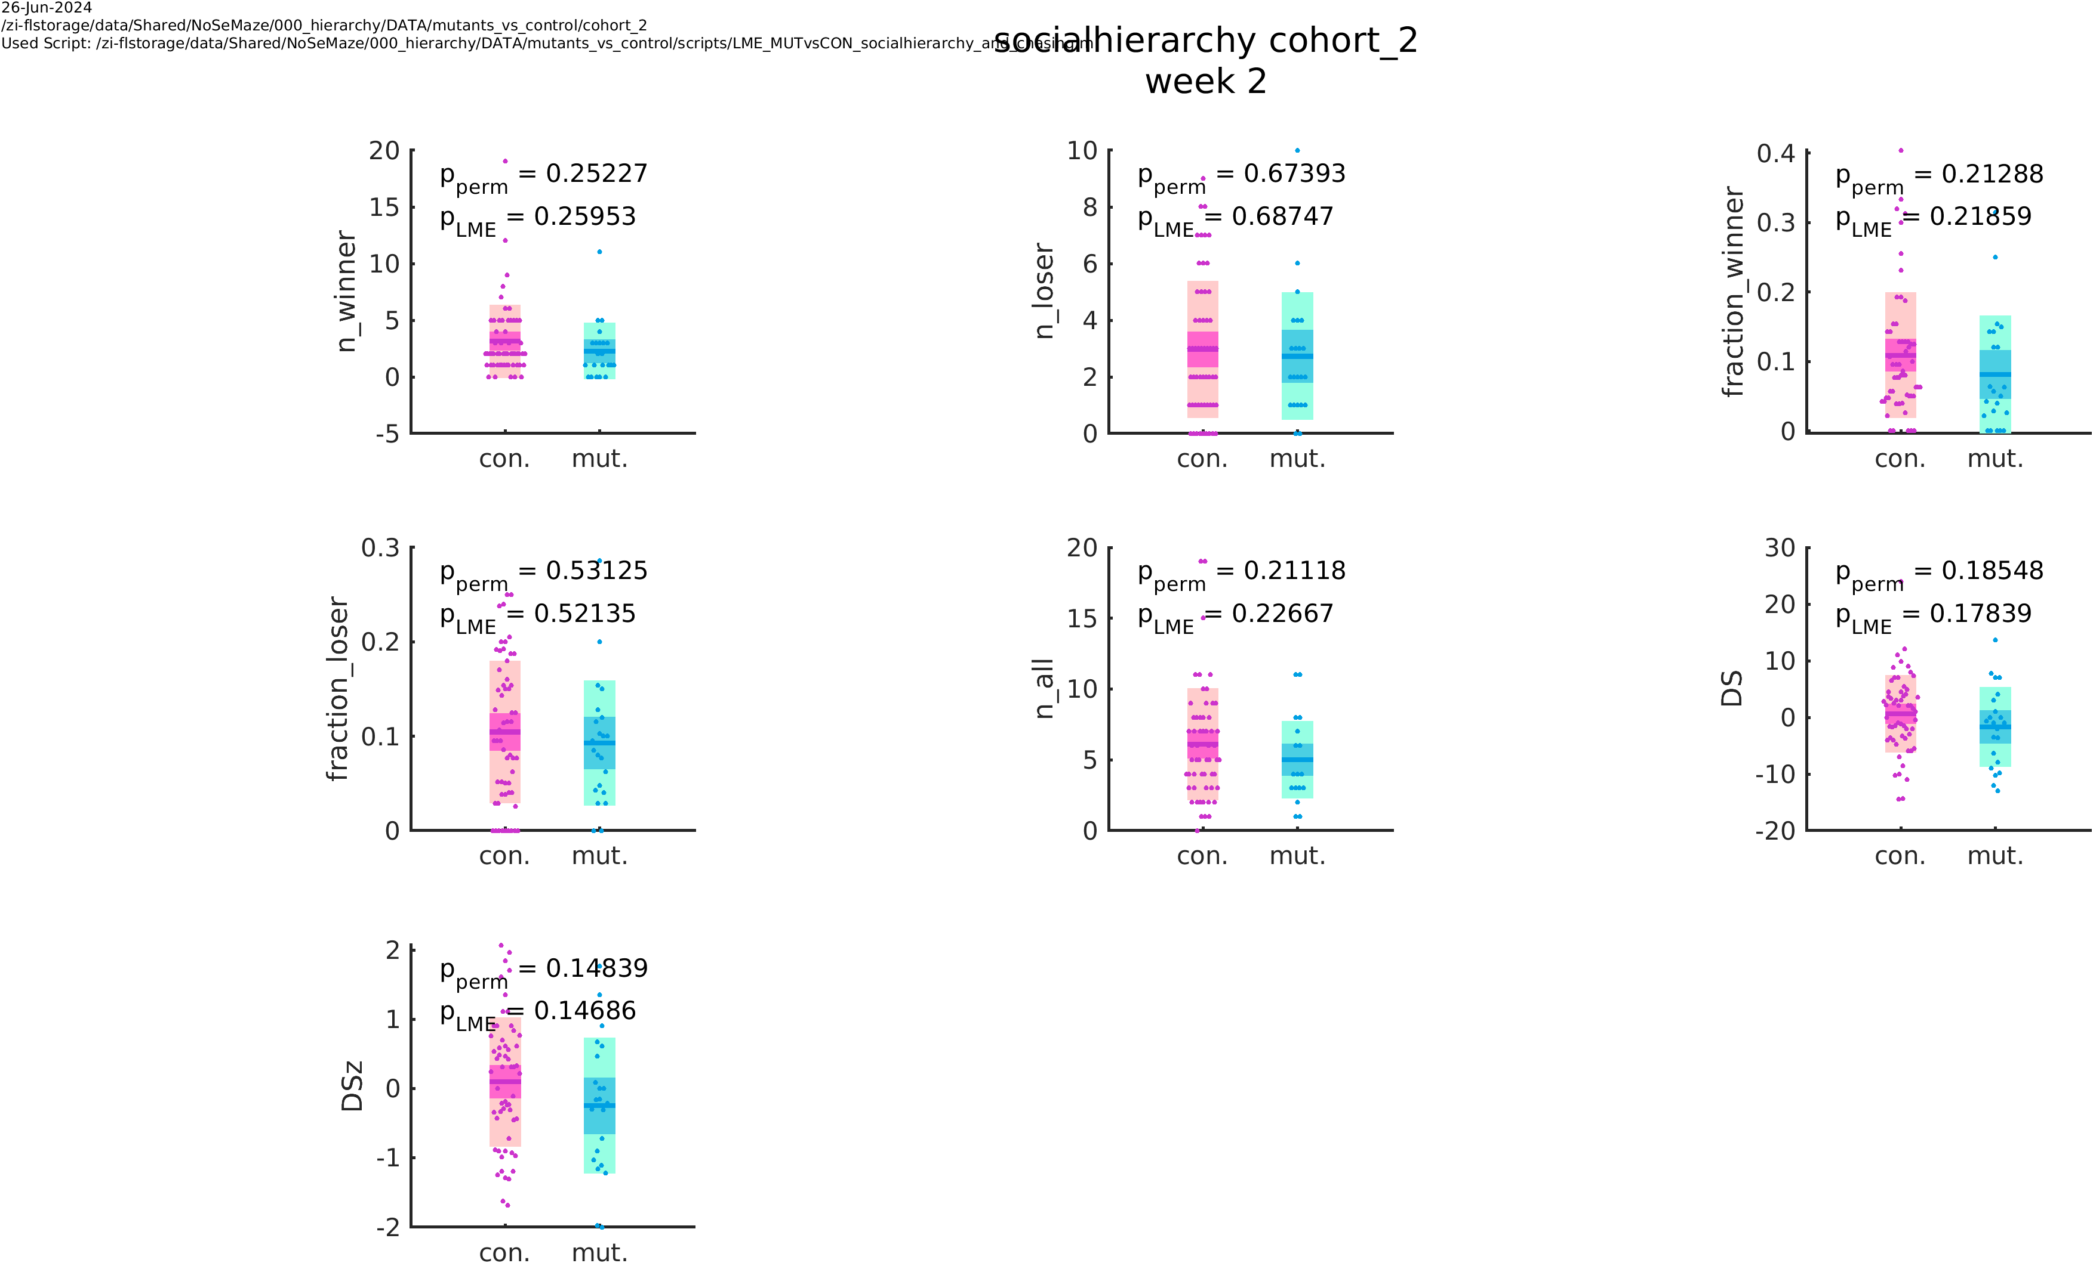
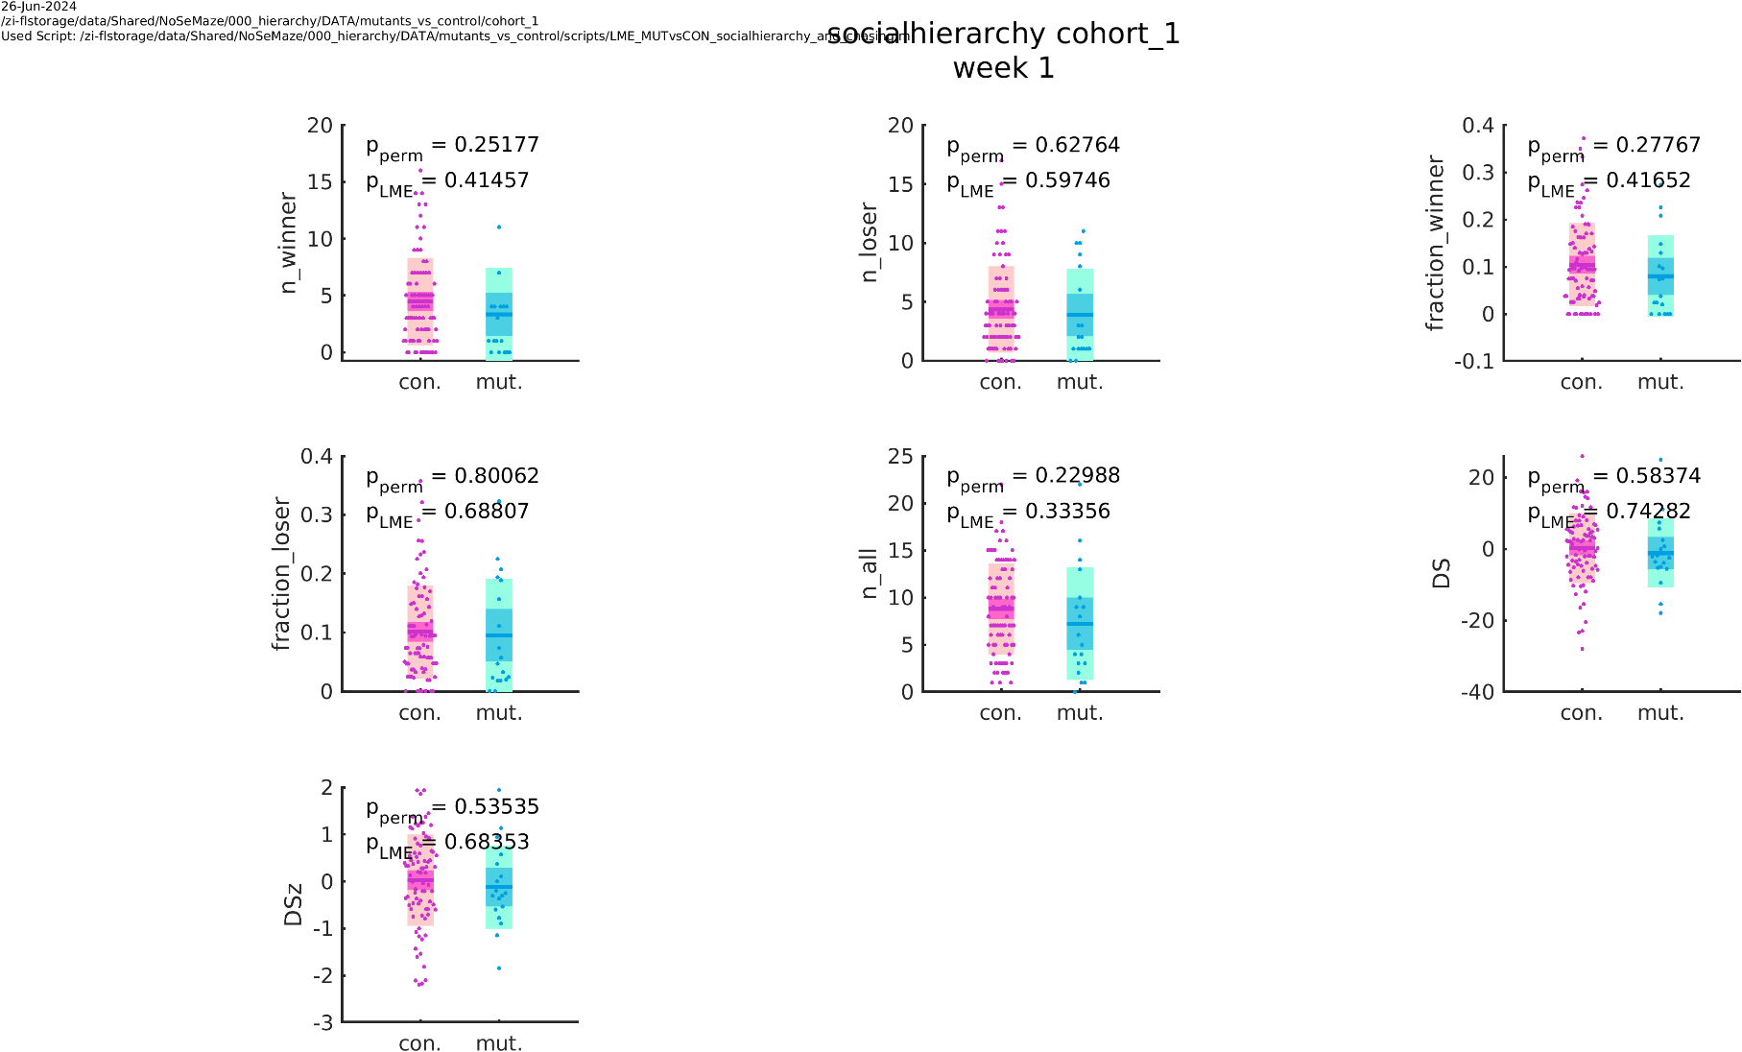
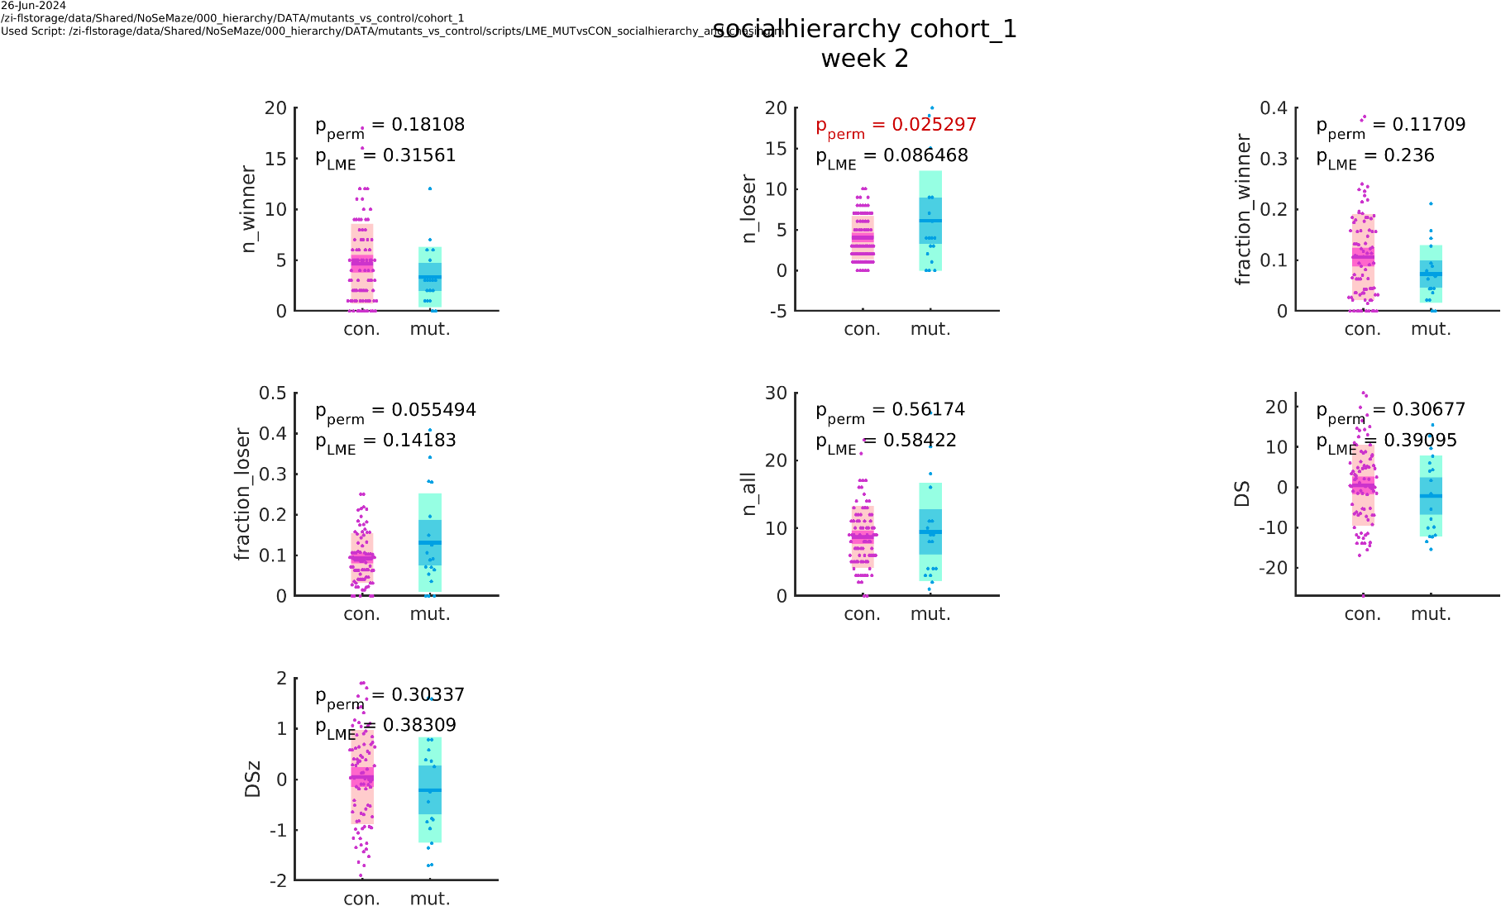
OXTR^{ΔAON} vs controls: social hierarchy
cohort 1 and 2
week 1
week 2
lower David‘s score in OXTR^{ΔAON} compared to controls in week 1 when combining both cohorts (old and young)
not significant in the second week
the effect is driven by the young cohort (week 1) and can not be observed in the old cohort
cohort 1
cohort 2 (young)
week 1
week 2
week 1
week 2

Slide 11
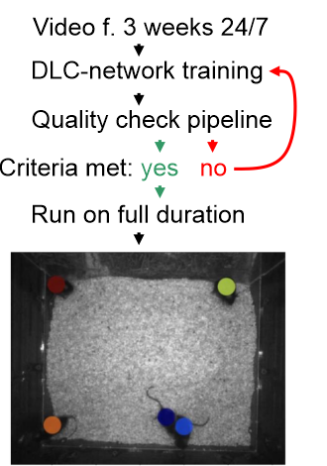
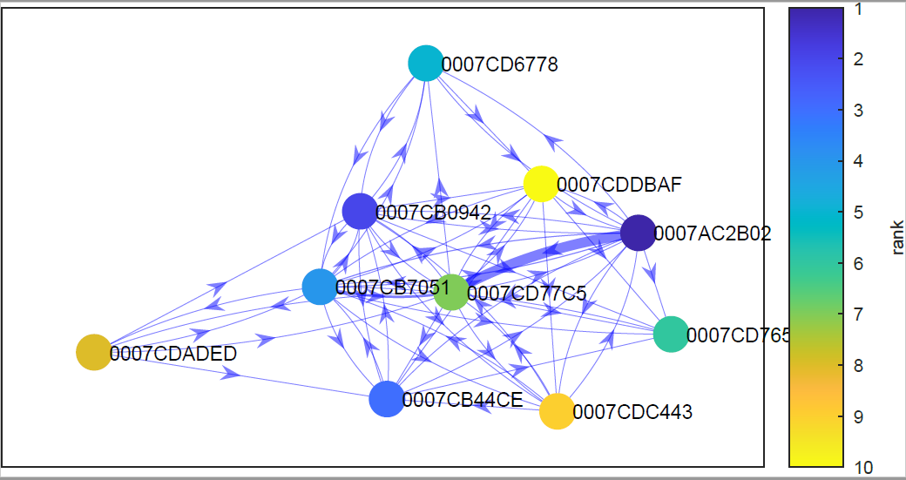
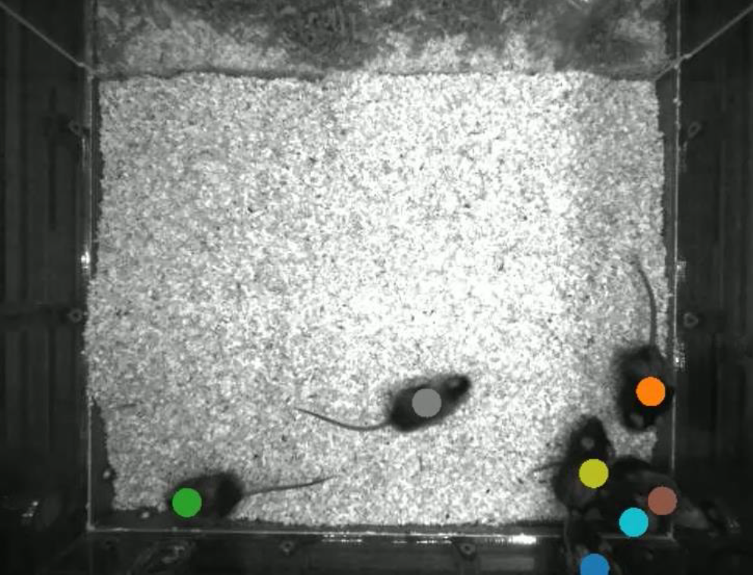
social interaction
dyadic interaction:
1-10 cm, >1 second
approaches:
calculated using the (smoothed) distance travelled in the 3-4 seconds before the interaction
distance travelled of mouse A must be at least 1.5x the distance travelled of mouse B
 | B02 | 7C5 | 765
B02 |  | 10 | 1
7C5 | 3 |  | 0
765 | 0 | 1
automated video tracking
directed and
weighted social networks
at different temporal resolutions
Social Network analysis:
rich club

Slide 12
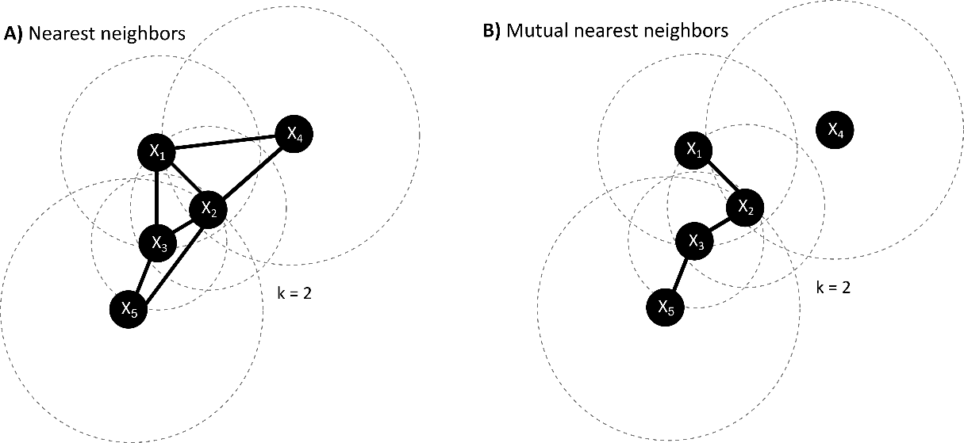
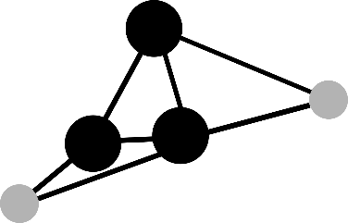
rich clubs
rich club
What is a “rich club”?
nodes with high connectivity that tend to form tightly interconnected groups or clusters among themselves
hierarchical organization in networks, where a small subset of highly connected nodes form a significant core

Slide 13
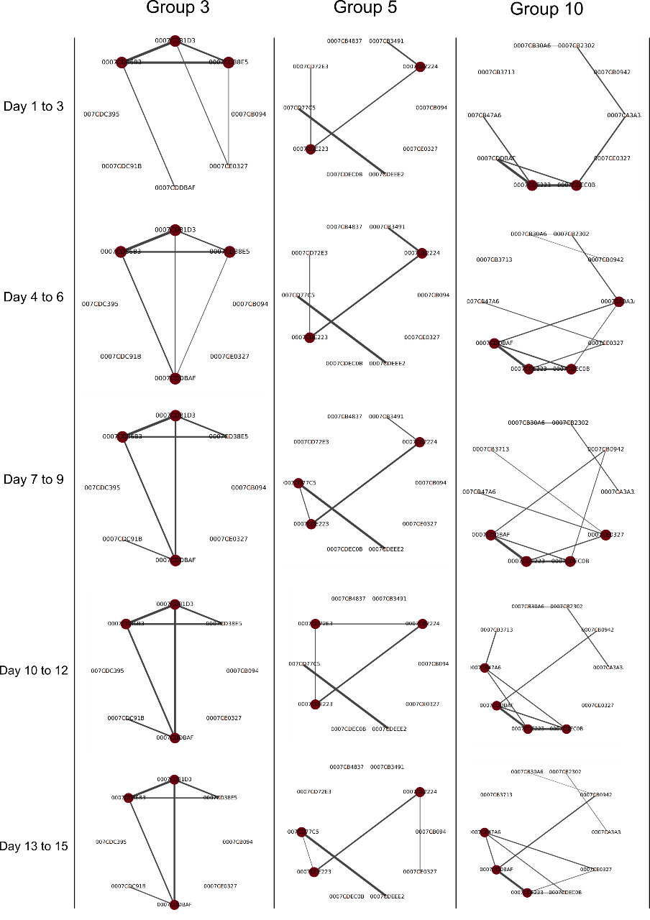
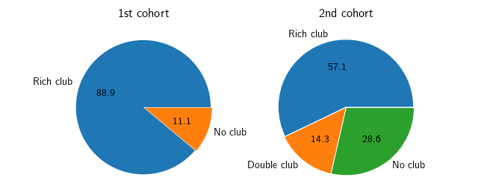
rich clubs
rich clubs are relatively stable over time
stable rich clubs are more consistently found in cohort 1
Proportions of observed stable rich clubs within the different groups.

Slide 14
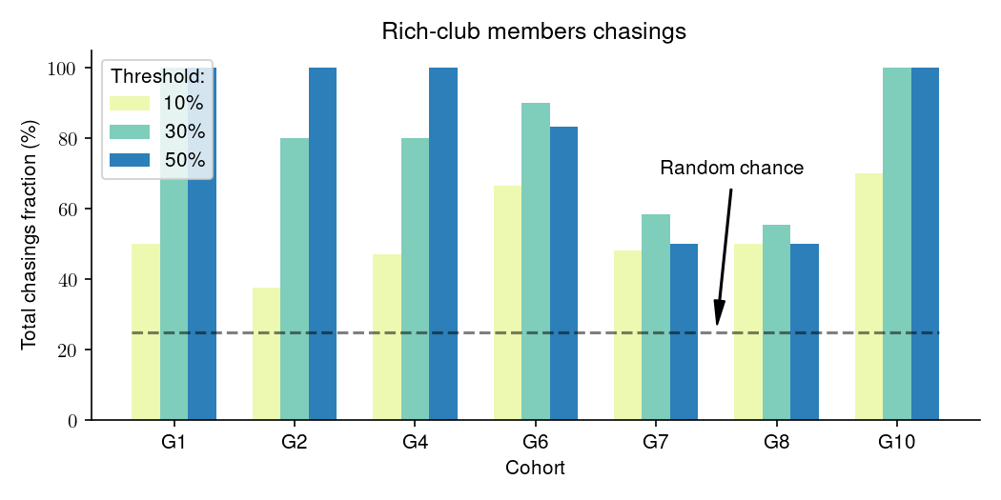
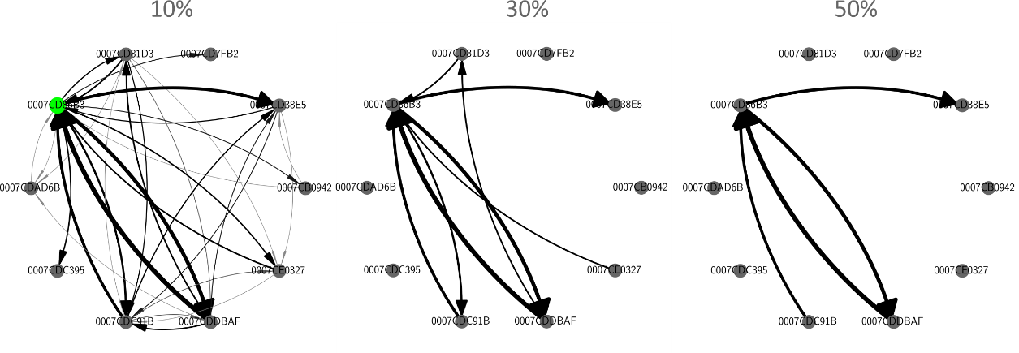
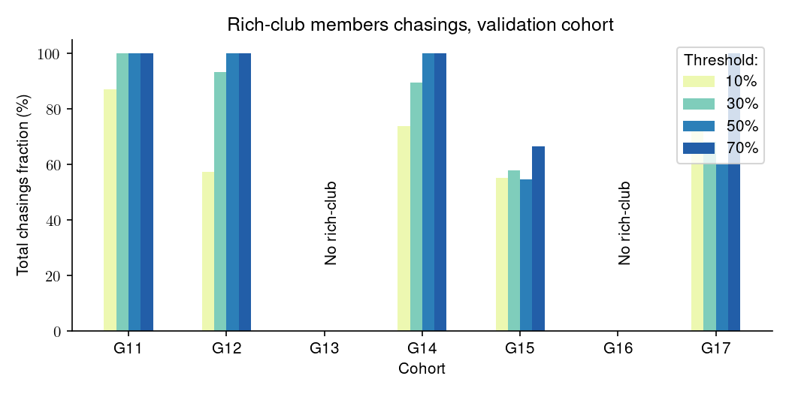
rich clubs and chasing
Examples of different thresholding on the chasing network
→ members of the rich club participate more in chasings
Is it combining „chasing“ and „being chased“

Slide 15
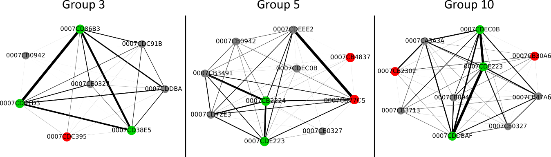
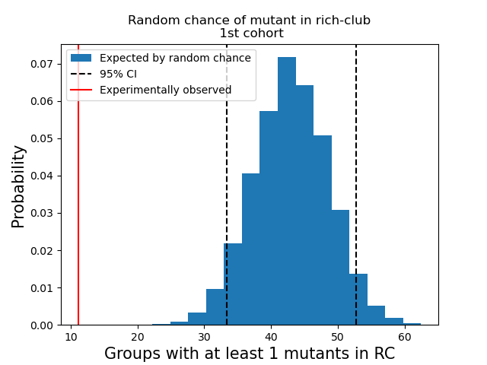
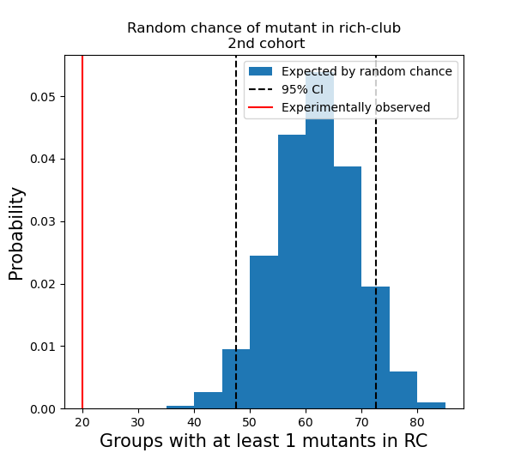
OXTR^{ΔAON} vs control animals: rich club
OXTR^{ΔAON} are excluded from the rich club

Slide 16
Questions
Nature of chasing
relation between chasing (rank) and social hierarchy in a stable environment
middle-aged vs. old
association between chasing and being chased
Relationship between chasing and rich club
members of the rich club participate more often in chasings
Impairment of mutants
social interaction: mutants are less frequent members of the rich club
social rank: age specific (in young) and „compensated“ over time
currently exploring more complex deficits between network metrics characterizing chasing and mutants

Slide 17
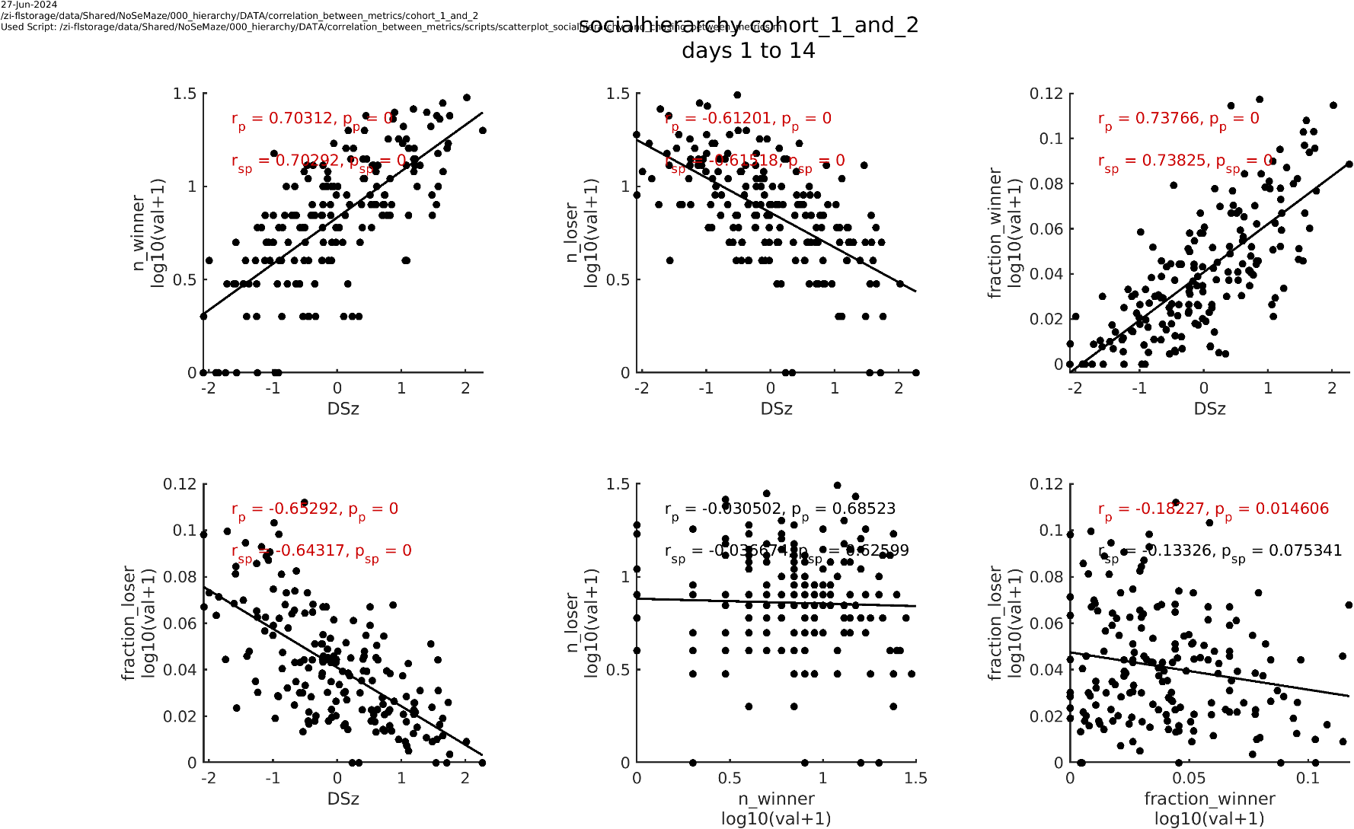
metric selection: social hierarchy
DSz (social hierachy) is driven by winning and losing of the tube contests
Winning and losing are not (or mildly negatively) associated
→ David‘s score is a good metric to characterize social hierarchy

Slide 18
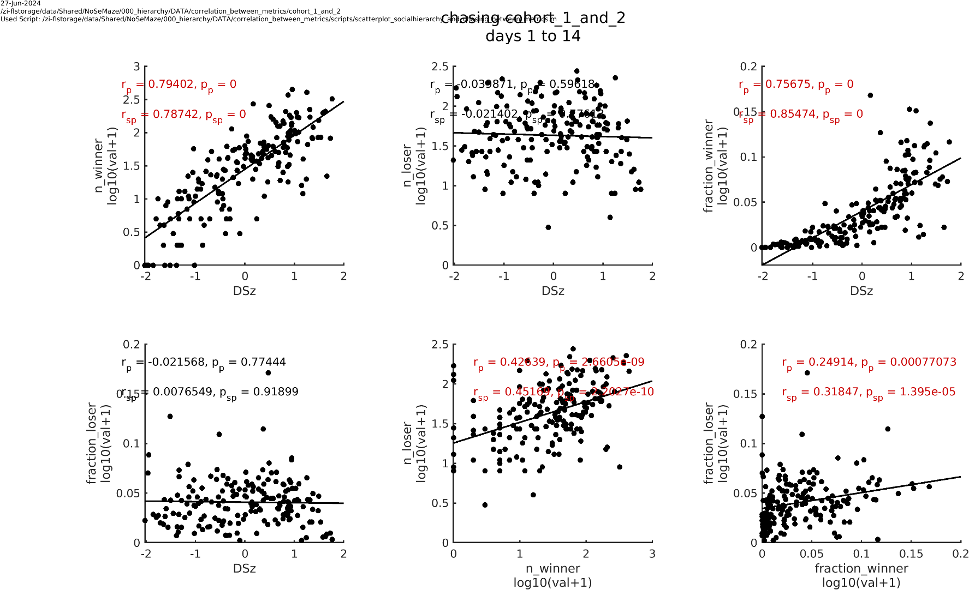
metric selection: chasing
DSz (chasing) is only driven by active chasing („winning“ of the chasing)
Chasing and being chased are positively correlated
→ Preferably used fraction of active chasings („fraction winner“)

Slide 19
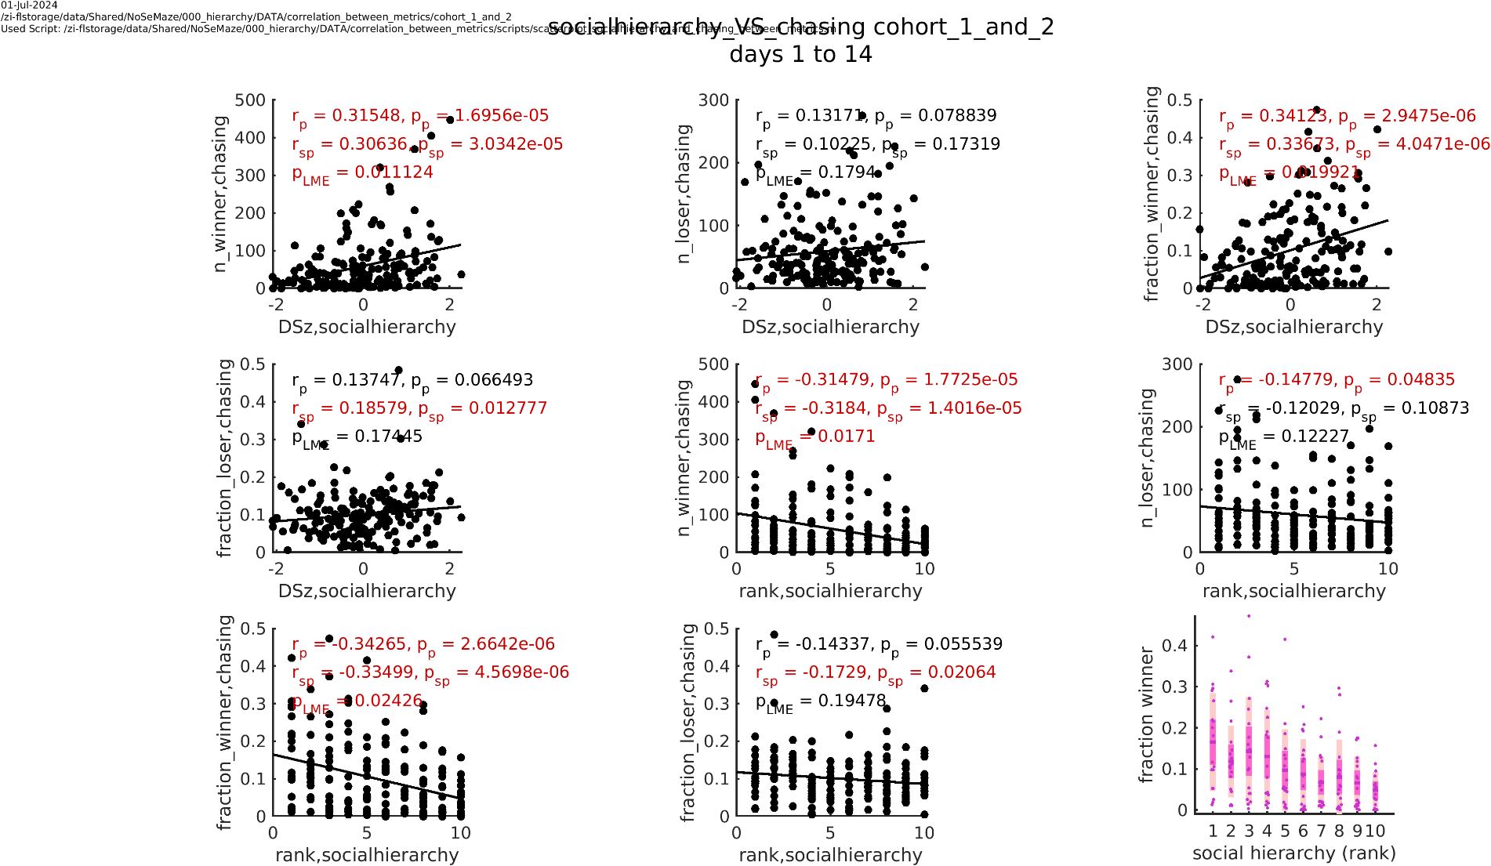
Who is chasing?
Animals with high social-hierarchy rank tend to chase more actively
But: No clear association for „being chased“, high rank animals even tend to be more often chased!
→ This is particularly true for the young animals (see next slide). Is it a playful behavior?

Slide 20
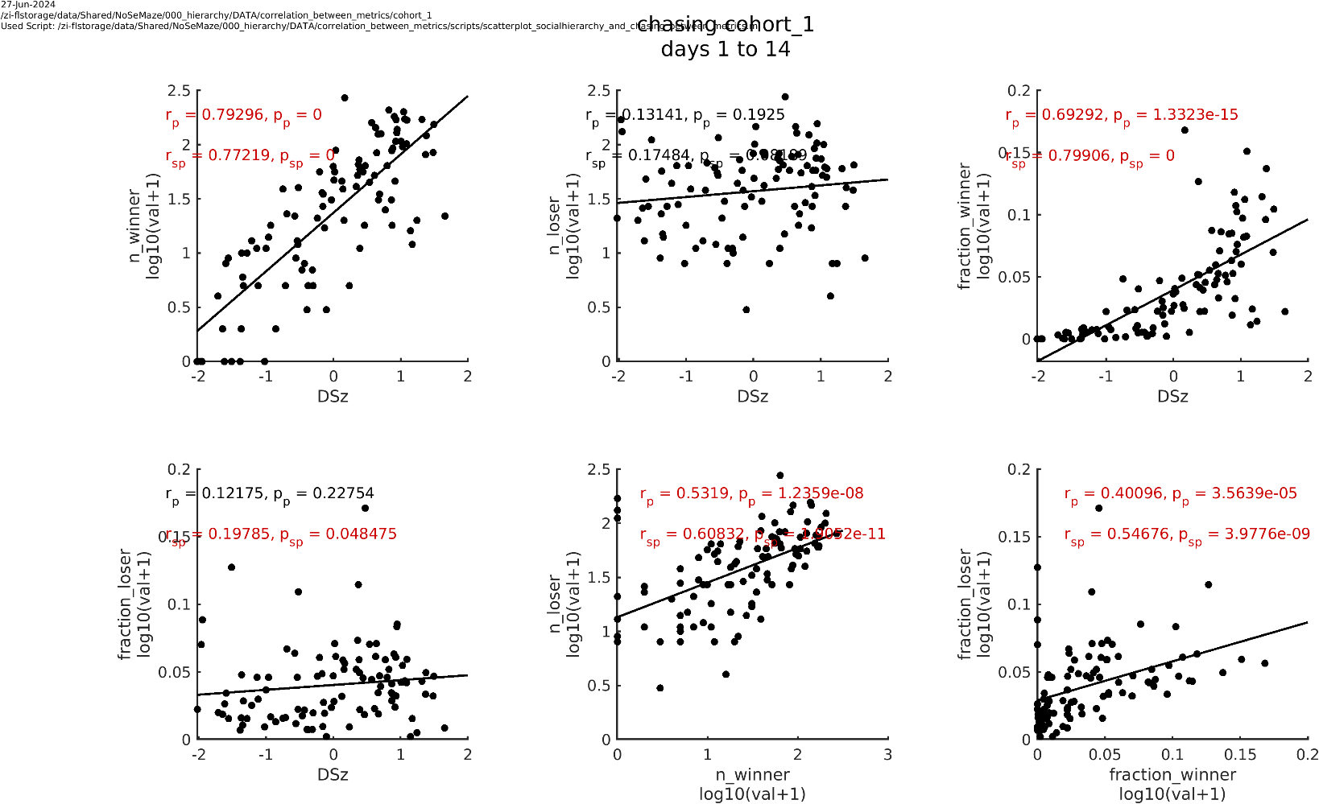
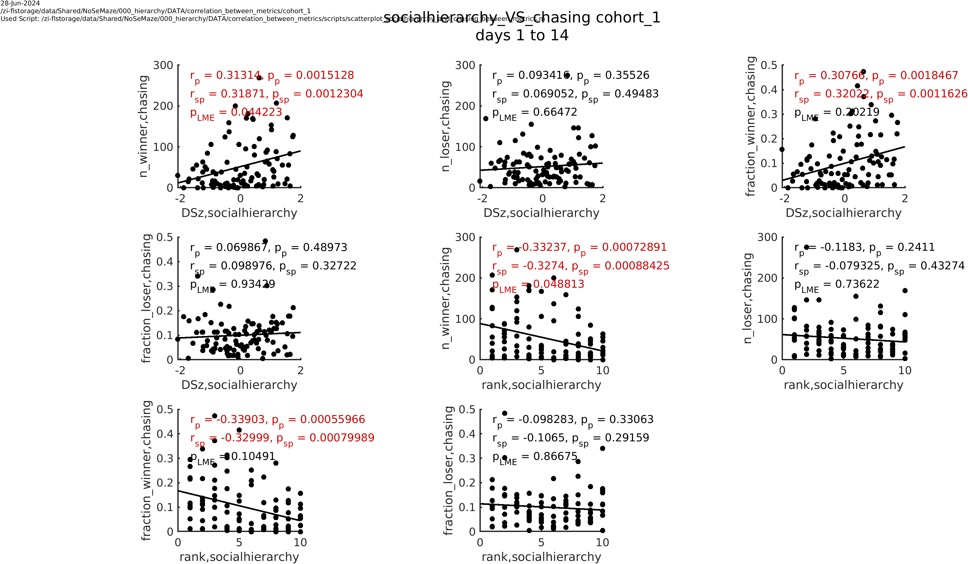
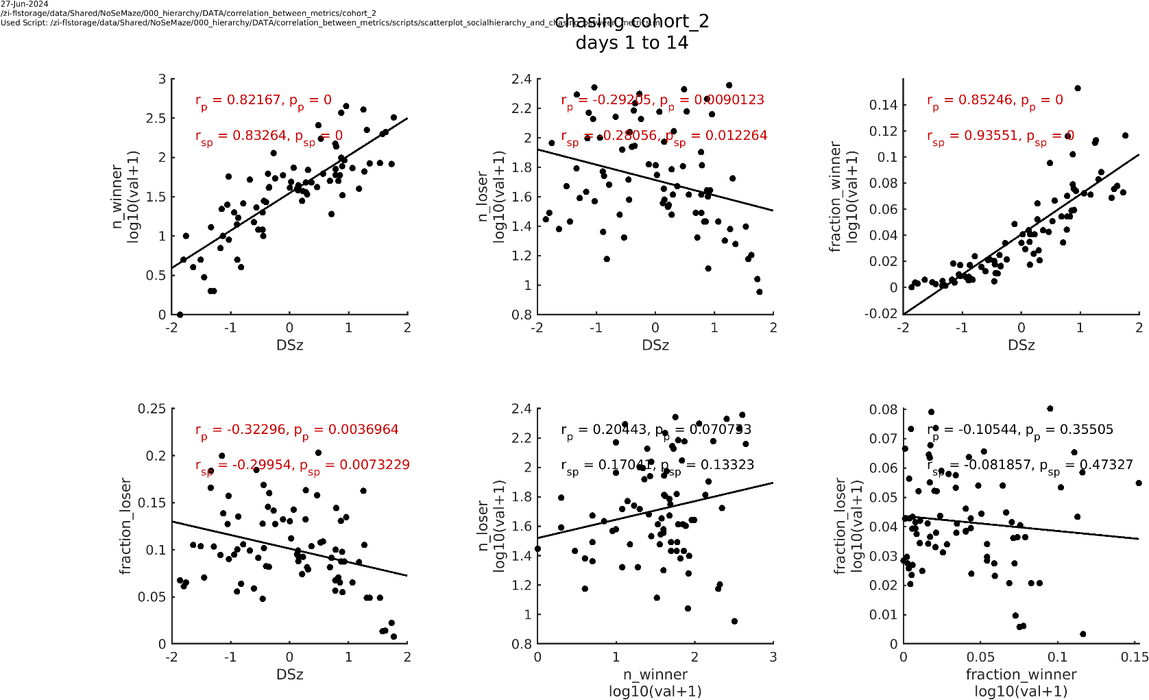
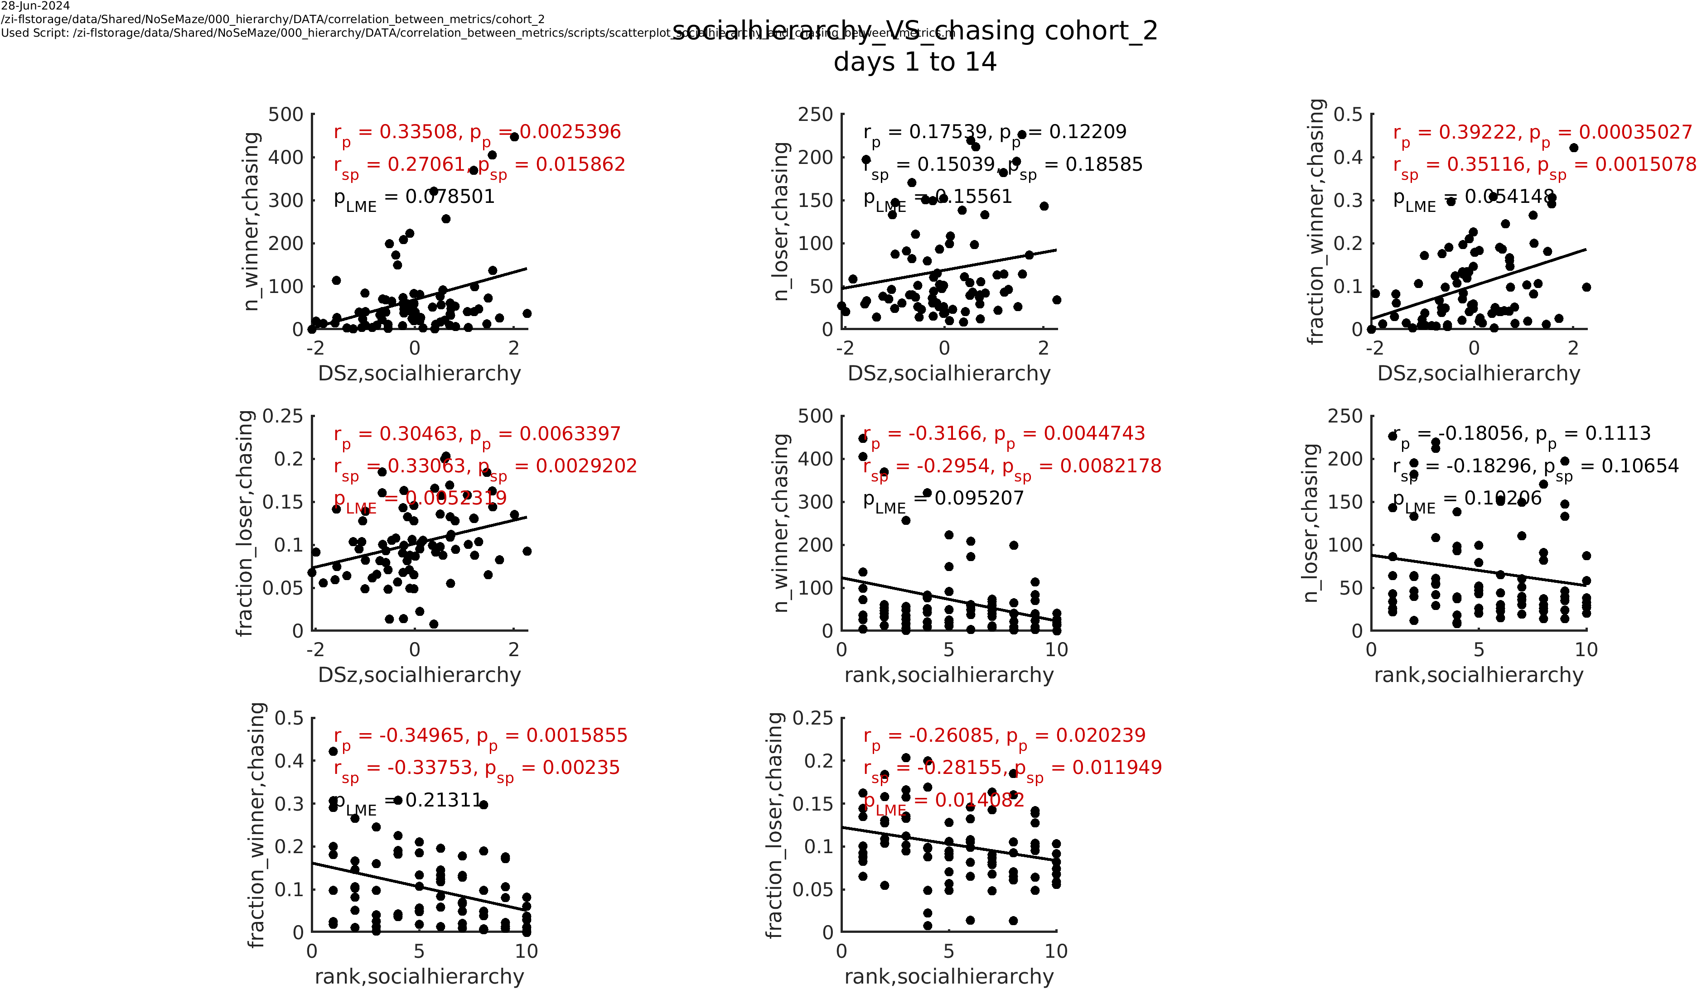
Who is chasing?
cohort 1 (old)
cohort 1 (old)
cohort 2 (young)
cohort 2 (young)

